Slide 1


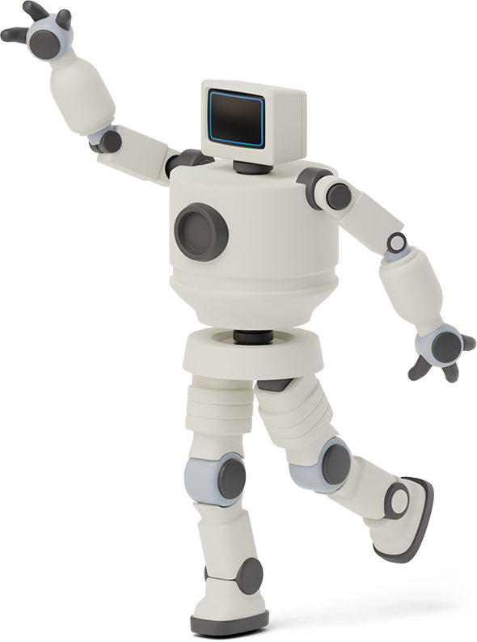

group k Nisham ghimire ashwin sapkota sashank baral aayush bhatta
The Bingo Game
Built with GTK

Slide 2
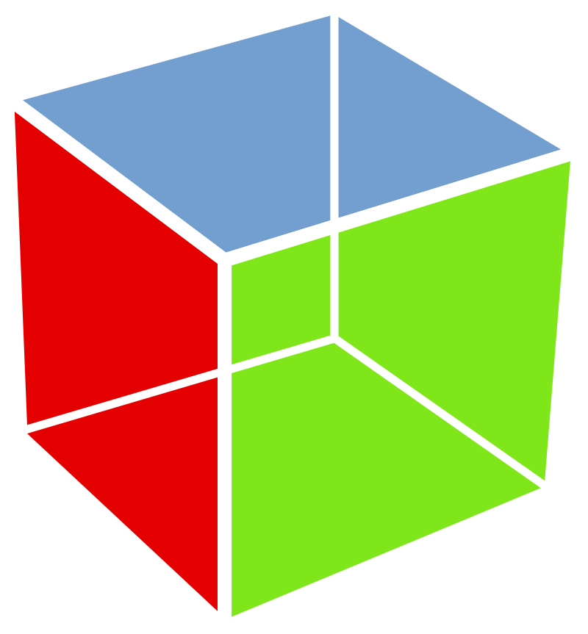

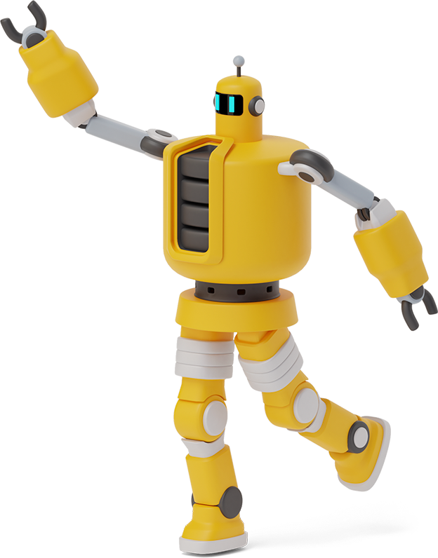
GtK
Toolkit to design GUI
Allows the use of widgets to draw anything
Gives access to several functions for creating these widgets
This project makes use of a few widgets such as buttons, pictures, and labels available in the GTK toolkit.
BINGO
5x5 grid board game
Each player gets a grid with 25 numbers placed in a random order
Numbers in a row, column, or a diagonal are all crossed out after they are called by any of the players
One who’s able to cross out all the numbers in a row, column, or diagonal eliminating all letters of the word "BINGO" first, wins the game.

Slide 3

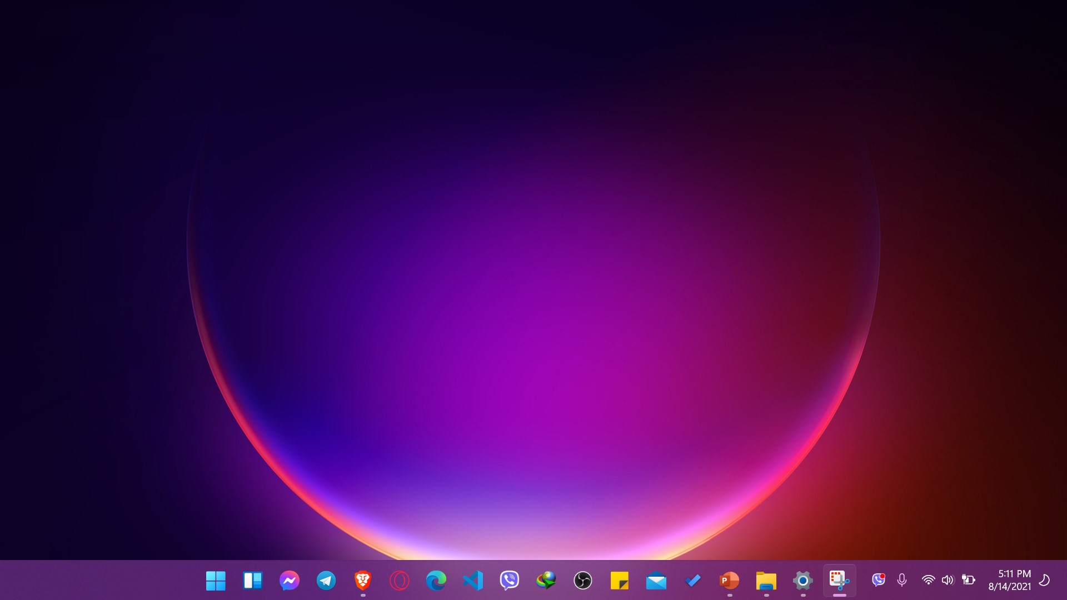
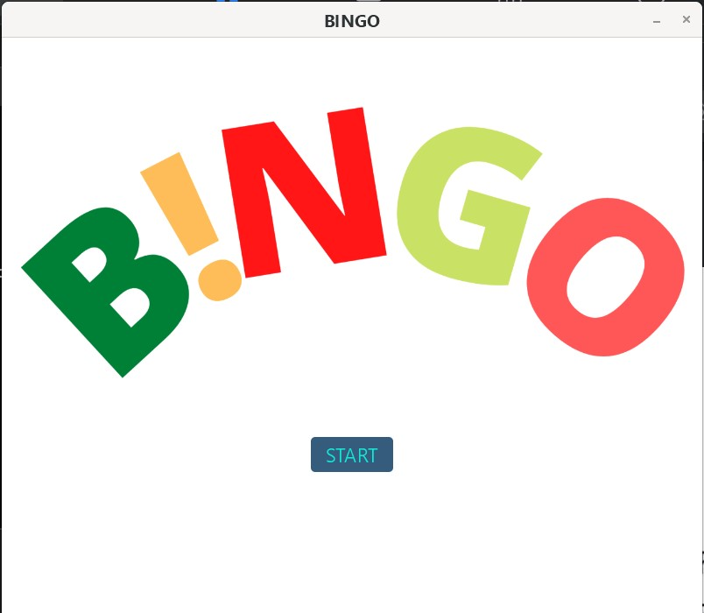
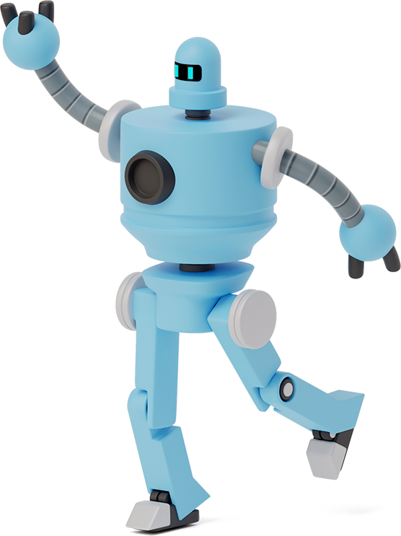

B!NGO!

Slide 4
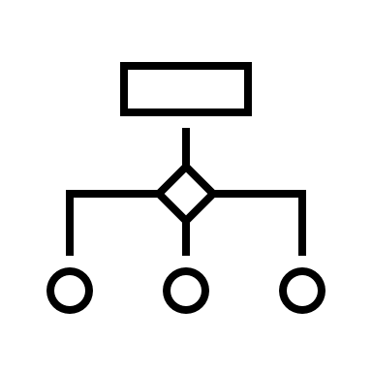
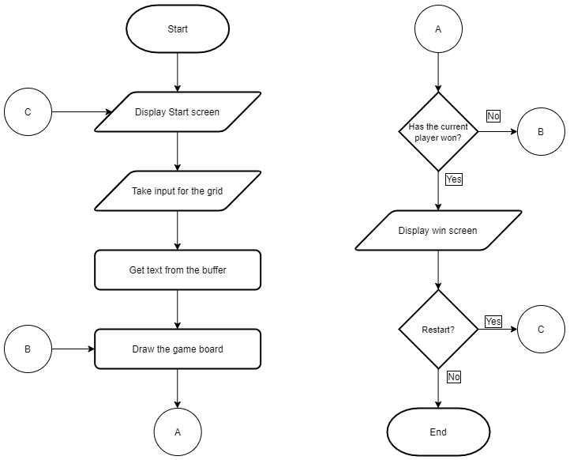

GENERAL Flowchart

Slide 5
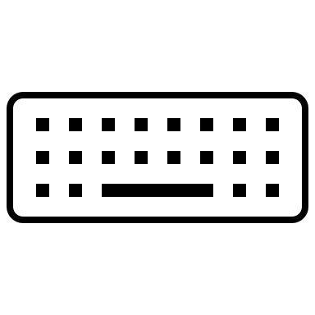
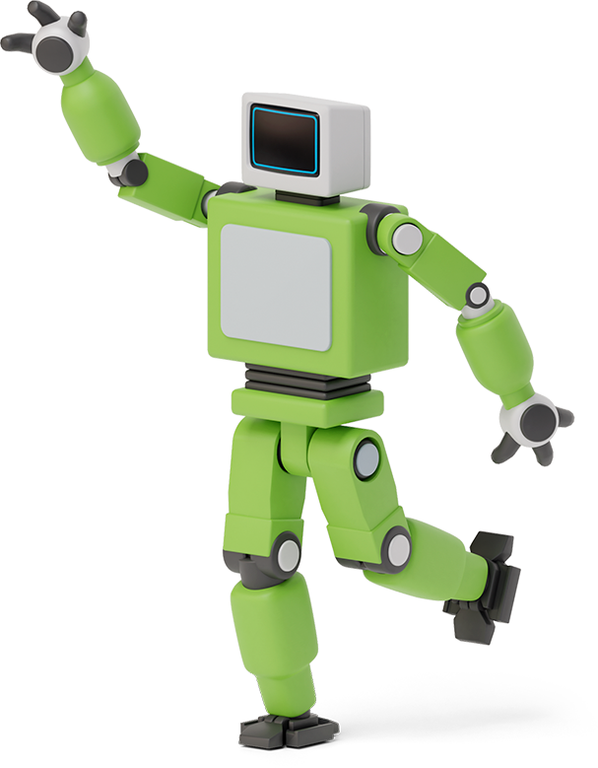

Input
Uses a 5x5 grid of gtk_entry widgets.
Each entry has a buffer set to it from which the input data is read
Attached to the input grid using a nested 'for' loop which uses a 2D array called entry[][]
The "OK" button at the bottom of the grid is connected to player_one or player_two, depending on which player the input grid was drawn for

Slide 6
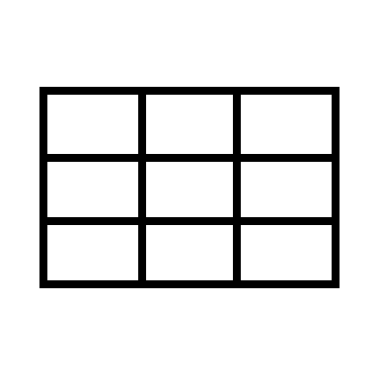
Draw grid
It is a 5x5 grid of gtk_button widgets
Input from the user is passed as an argument to gtk_button_new_with_label()
The 25 buttons are attached to gtk_grid using a nested loop that uses a 2D array of gtk_button
Each button is connected to replace() through the "clicked" signal

Slide 7


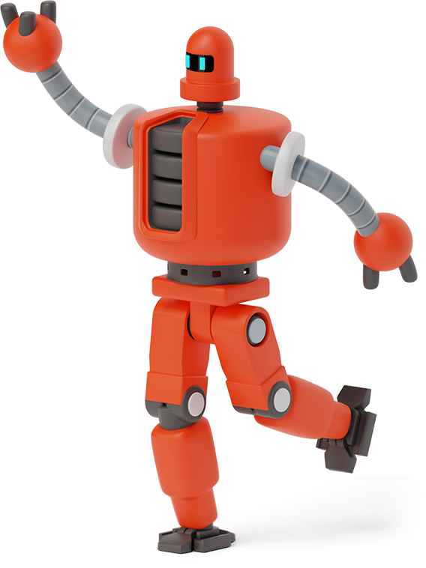
Deciding the winner
replace() function reads the label of the button that was clicked and replaces it with the letter "X"
replace() calls the check_win functions
The check_win functions check each row, column, and diagonal for the winning criteria
If true, the display_win_screen() function is called
If false, the game displays the grid for the subsequent player
When a row, column, or diagonal has been crossed, one of the letters from "BINGO" gets eliminated

Slide 8


CSS
Coding language used for look and layout.
Can set font size, apply colors to backgrounds and texts
Helps in designing buttons and their positions
#button {
background: #355C7D;
color:#12e6d4;
font-size: 22px;
}
#button:active {
background:#5968eb;
font-size: 22px;
}
#win {
background-color: #73ceff;
font-size: 20px;
}
mainBox
button
button:hover
APR
button:active
gridbtn, gridlabel
win
#button:hover {
background:#00ABF0;
}
#gridbtn, #gridlabel {
color: #042216c5;
font-size: 25px;
}
#mainBox{
background-color: white;
}

Slide 9
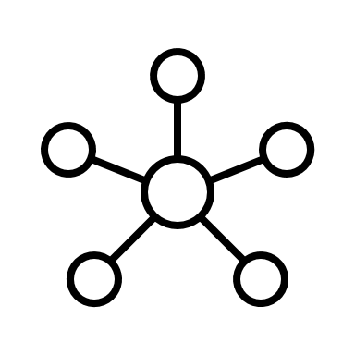
Compiling and linking
Four folders - 'css', 'img', 'src' and 'include’.
'css' contains the themes.css file used to style the widgets
'img' contains the image used on the first screen.
'src' and 'include' contain the source files and their dependencies
A makefile is used to compile and link these files into an executable called 'bingo’; it uses simple macros and string manipulation functions
The object files generated by the makefile are stored in 'src/obj'

Slide 10

Team Presentation
Nisham Ghimire
Sashank Baral
Thank You!
Aayush Bhatta
Ashwin Sapkota

